Slide 1
Measuring Data Similarity and Dissimilarity

Slide 2
Similarity and Dissimilarity
Similarity
Numerical measure of how alike two data objects are
Value is higher when objects are more alike
Often falls in the range [0,1]
Dissimilarity (e.g., distance)
Numerical measure of how different two data objects are
Lower when objects are more alike
Minimum dissimilarity is often 0
Upper limit varies
Proximity refers to a similarity or dissimilarity

Slide 3
Data Matrix and Dissimilarity Matrix
Data matrix
n data points with p dimensions
Dissimilarity matrix
n data points, but registers only the distance
A triangular matrix

Slide 4

Proximity Measure for Nominal Attributes
Can take 2 or more states, e.g., red, yellow, blue, green (generalization of a binary attribute)
Method 1: Simple matching
m: # of matches, p: total # of variables
Object | Attribute | Color | Quality
i | red | good
j | blue | good

Slide 5


Proximity Measure for Nominal Attributes
Method 2: Use a large number of binary attributes
creating a new binary attribute for each of the m nominal states
Let, Color = {red, yellow, blue, green} and
Quality = {good, bad}
For symmetric:
For asymmetric:
Object | red | yellow | blue | green | good | bad
i | 1 | 0 | 0 | 0 | 1 | 0
j | 0 | 0 | 1 | 0 | 1 | 0

Slide 6
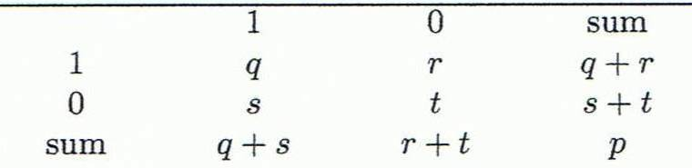
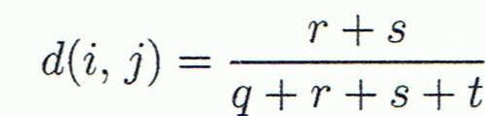
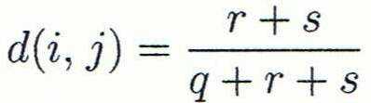
Proximity Measure for Binary Attributes
A contingency table for binary data
Distance measure for symmetric binary variables:
Distance measure for asymmetric binary variables:
Object j
Object i

Slide 7
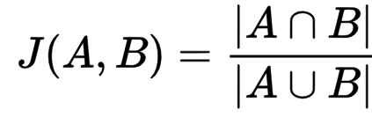

Jaccard Coefficient
The Jaccard Similarity will be 0 if the two sets don't share any values and 1 if the two sets are identical.
The set may contain either numerical values or strings.
Additionally, this function can be used to find the dissimilarity between two sets by calculating d(A,B)=1–J(A,B)
Example: Compute the Jaccard similarity:
A={0,1,2,5,6} and B={0,2,3,4,5,7,9}
Jaccard Similarity between two sets is calculated as follows:

Slide 8

Jaccard Coefficient for Binary Attributes
A contingency table for binary data
Jaccard coefficient (similarity measure for asymmetric binary variables):
Object j
Object i
Note: Jaccard coefficient is the same as “coherence”:

Slide 9
Dissimilarity using Asymmetric Binary Variables
Example:
Gender is a symmetric attribute (nominal)
The remaining attributes are asymmetric binary
Let the values Y and P be 1, and the value N be 0

Slide 10



Dissimilarity using Interval-Scaled Variables
Commonly used methods are distance based dissimilarity.
Generally, variables are standarized before measuring dissimilarity.
Standarization Steps:
Calculate the mean absolute deviation, S_{f} , where x_{1f}, …, x_{nf} are n measurements of f, and m_{f} is the mean value of f, i.e.,
Calculate the standarized measurement, or Z-score:

Slide 11
Example: Data Matrix and Dissimilarity Matrix
Data Matrix
Dissimilarity Matrix
(with Euclidean Distance)

Slide 12
Distance on Numeric Data: Minkowski Distance
Minkowski distance: A popular distance measure
where i = (x_{i1}, x_{i2}, …, x_{ip}) and j = (x_{j1}, x_{j2}, …, x_{jp}) are two p-dimensional data objects, and h is the order (the distance so defined is also called L-h norm)
Properties
d(i, j) > 0 if i ≠ j, and d(i, i) = 0 (Positive definiteness)
d(i, j) = d(j, i) (Symmetry)
d(i, j) ≤ d(i, k) + d(k, j) (Triangle Inequality)
A distance that satisfies these properties is a metric

Slide 13
Special Cases of Minkowski Distance
h = 1: Manhattan (city block, L₁ norm) distance
E.g., the Hamming distance: the number of bits that are different between two binary vectors
h = 2: (L₂ norm) Euclidean distance
h → ∞. “supremum” (L_{max} norm, L∞ norm) distance.
This is the maximum difference between any component (attribute) of the vectors

Slide 14
Example: Minkowski Distance
Dissimilarity Matrices
Manhattan (L₁)
Euclidean (L₂)
Supremum

Slide 15
Ordinal Variables
An ordinal variable can be discrete or continuous
Order is important, e.g., rank
Can be treated like interval-scaled
replace x_{if} by their rank
map the range of each variable onto [0, 1] by replacing i-th object in the f-th variable by Min-Max normalization
compute the dissimilarity using methods for interval-scaled variables (like Euclidean distance etc.)

Slide 16
Ratio-Scaled Variable
A ratio scaled variable makes a positive measurement on a nonlinear scale, such as an exponential scale, approximately following the formula Ae^{Bt} or Ae^{-Bt}, where A and B are positive constants.
Typical examples: growth of a bacteria population, decay of a radioactive element
How to compute dissimilarity: Generally 3 methods:
1. Treat ratio-scaled variables as interval scaled variables. This is not usually a good choice since it is likely that the scaled may be distorted.

Slide 17
Ratio-Scaled Variable
2. Apply logarithmic transformation to a ratio-scaled variable f having value x_{if} for object i by using the formula y_{if} = log(x_{if}), and then y_{if} values can be treated as interval-valued. For some ratio-scaled variables, log-log or other transformation may be applied, depending on the definition and application.
3. Treat xif as continuous ordinal data and treat their ranks as interval-valued.
The latter two methods are the most effective, although the choice of method used may be dependent on the given application.

Slide 18
Attributes of Mixed Type
A database may contain all attribute types
Nominal, symmetric binary, asymmetric binary, numeric, ordinal
One may use a weighted formula to combine their effects
Where the indicator δ_{ij}^{(f)} = 0 if if either
x_{if} or x_{jf} is missing or
x_{if} = x_{jf} =0 and variable f is asymmetric binary
Otherwise: δ_{ij}^{(f)} = 1

Slide 19

Attributes of Mixed Type
The contribution of variable f to the dissimilarity between i and j, i.e., d_{ij}^{(f)} , is computed depending on its type:
If f is binary or nominal:
d_{ij}^{(f)} = 0 if x_{if} = x_{jf} , otherwise d_{ij}^{(f)} = 1
If f is interval-scaled: , where
h runs over all nonmissing objects for variable f.
If f is ordinal or ratio-scaled:
Compute ranks r_{if} and
Treat z_{if} as interval-scaled

Slide 20
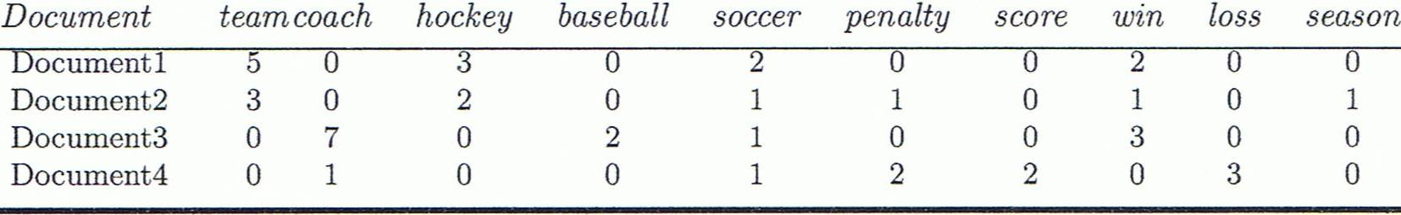
Cosine Similarity
A document can be represented by thousands of attributes, each recording the frequency of a particular word (such as keywords) or phrase in the document.
Other vector objects: gene features in micro-arrays, …
Applications: information retrieval, biologic taxonomy, gene feature mapping, ...
Cosine measure: If d₁ and d₂ are two vectors (e.g., term-frequency vectors), then
cos(d₁, d₂) = (d₁ • d₂) /||d₁|| ||d₂|| ,
where • indicates vector dot product, ||d||: the length of vector d

Slide 21
Example: Cosine Similarity
cos(d₁, d₂) = (d₁ • d₂) /||d₁|| ||d₂|| ,
where • indicates vector dot product, ||d|: the length of vector d
Ex: Find the similarity between documents 1 and 2.
d₁ = (5, 0, 3, 0, 2, 0, 0, 2, 0, 0)
d₂ = (3, 0, 2, 0, 1, 1, 0, 1, 0, 1)
d₁•d₂ = 5*3+0*0+3*2+0*0+2*1+0*1+0*0+2*1+0*0+0*1 = 25
||d₁||= (5*5+0*0+3*3+0*0+2*2+0*0+0*0+2*2+0*0+0*0)^{0.5}=(42)^{0.5} = 6.481
||d₂||= (3*3+0*0+2*2+0*0+1*1+1*1+0*0+1*1+0*0+1*1)^{0.5}=(17)^{0.5} = 4.12
cos(d₁, d₂ ) = 0.94

Slide 22
Criteria | Cosine Similarity | Euclidean Similarity
Definition | Measures the cosine of the angle between two vectors. | Measures the distance between two vectors.
Magnitude Sensitivity | Insensitive to the magnitude of vectors. | Sensitive to the magnitude of vectors.
Dimensionality | Well-suited for high-dimensional spaces. | Works better in lower-dimensional spaces.
Data Sparsity | Effective for sparse data, such as text data. | May not perform well with sparse data.
Orthogonality | Handles orthogonality well, distinguishing between similar vectors even if their magnitudes vary. | Tends to struggle with orthogonality, as it considers the direct distance.
Normalization | Requires normalized vectors for accurate results. | Normalization is not required.
Application | Commonly used in natural language processing, document similarity, and recommendation systems. | Commonly used in clustering, classification, and dimensionality reduction.
Computation Complexity | Generally less computationally intensive. | Can be computationally intensive in high dimensions due to the square root operation.

Slide 23
Feature Selection

Slide 24
Feature Selection
Recent advancements in IT have produced the rapid production of big data, as enormous volumes of data with high dimensional features grow exponentially in different fields.
Therefore, dealing with high-dimensional data creates new challenges in terms of data processing efficiency and effectiveness.
To address such challenges, Feature Selection (FS) is among the most utilized dimensionality reduction methods.

Slide 25
Feature Selection
It is a process that reduces the high dimensionality of large-scale data by selecting a small subset of related and significant features and eliminating unrelated and redundant features in order to construct effective prediction models.
It is of two broad categories: Supervised feature selection and unsupervised feature selection
Notes:
25

Slide 26
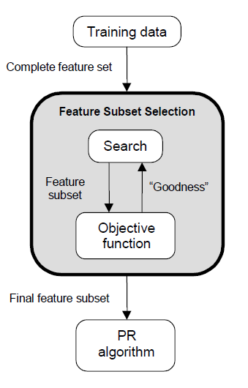
Feature Selection
Feature selection is an optimization problem.
Search the space of possible feature subsets.
Pick the subset that is optimal or near-optimal with respect to some objective function.

Slide 27
Feature Selection
Search methods
Exhaustive
Heuristic
Evaluation methods
Filter
Wrapper

Slide 28
Search Methods
Assuming n features, an exhaustive search would
require examining possible subsets of size d.
The number of subsets grows exponentially, and time required to find out the suitable subset of features is O(2^{n}), which makes the exhaustive search impractical.
In practice, heuristics are used to speed-up search but they cannot guarantee optimality.

Slide 29
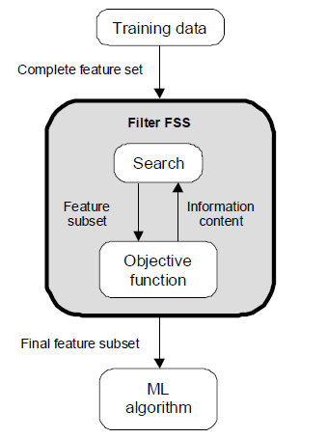
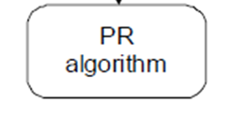
Evaluation Methods
Filter
Evaluation is independent of the classification Algorithm.
The objective function is based on the information content of the feature subsets, e.g.:
interclass distance
statistical dependence
information-theoretic measures (e.g., mutual information).
“goodness”

Slide 30
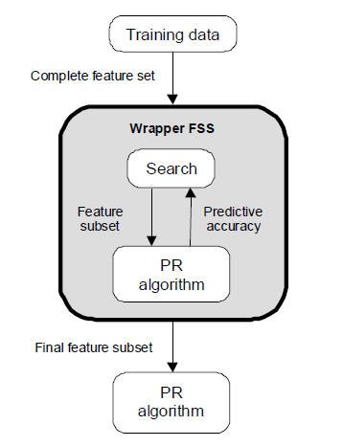
Evaluation Methods
Wrapper
Evaluation uses criteria related to the classification algorithm.
The objective function is based on the predictive accuracy of the classifier
“goodness”

Slide 31
Wrapper: Decision Tree Induction
Initial attribute set:
{A1, A2, A3, A4, A5, A6}
A4 ?
A1?
A6?
Class 1
Class 2
Class 1
Class 2
>
Selected Feature subset: {A1, A4, A6}
31

Slide 32
Filter vs Wrapper Methods
Filter Methods
Advantages
Much faster than wrapper methods since the objective function has lower computational requirements.
The optimum feature set might work well with various classifiers as it is not tied to a specific classifier.
Disadvantages
Have a tendency to select more features compared to wrapper methods.
Achieve lower recognition accuracy compared to wrapper methods.

Slide 33
Filter vs Wrapper Methods
Wrapper Methods
Advantages
Achieve higher recognition accuracy compared to filter methods since they use the classifier itself in choosing the optimum set of features.
Disadvantages
Much slower compared to filter methods since the classifier must be trained and tested for each candidate feature subset.
The optimum feature subset might not work well for other classifiers.

Slide 34
Heuristic Search - Naïve Search
Given n features:
Sort them in decreasing order of their “goodness” based on some objective function.
Choose the top d features from this sorted list.
Disadvantages
Correlation among features is not considered.
The best pair of features may not even contain the best individual feature.

Slide 35
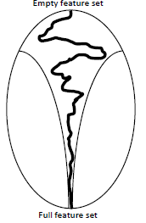
Heuristic Search : Step-wise Forward Selection (SFS)
First, the best single feature is selected based on some objective function.
Then, pairs of features are formed using one of the remaining features and this best feature, and the best pair is selected.
Next, triplets of features are formed using one of the remaining features and these two best features, and the best triplet is selected.
This procedure continues until a predefined number of features are selected.
SFS performs
best when the
optimal subset is
small.

Slide 36
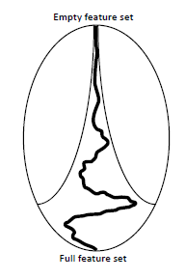
Heuristic Search : Step-wise Backward Removal (SBR)
One feature among n features is deleted:
the objective function is computed for all
subsets with n-1 features, and the worst
feature is discarded.
Next, one feature among remaining n-1 features is deleted:
the objective function is computed for all
subsets with n-2 features, and the worst
feature is discarded.
This procedure continues until a predefined number of features are left.
SBR performs
best when the
optimal subset is
large.

Slide 37
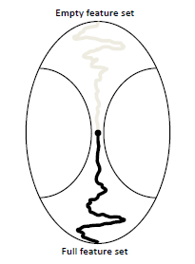
Bidirectional Search (BDS)
BDS applies SFS and SBR simultaneously:
SFS is performed from the empty set.
SBR is performed from the full set.
To guarantee that SFS and SBR converge to the same solution:
Features already selected by SFS cannot be removed by SBR.
Features already removed by SBR cannot be added by SFS.

Slide 38
Limitations of SFS and SBR
The main limitation of SFS is that it is unable to remove features that become non useful after the addition of other features.
The main limitation of SBR is its inability to reevaluate the usefulness of a feature after it has been discarded.
Enhancements of SFS and SBR:
“Plus-L, minus-R” selection (LRS)
Step-wise Floating Forward Selection (SFFS)
Step-wise Floating Backward Removal (SFBR)

Slide 39
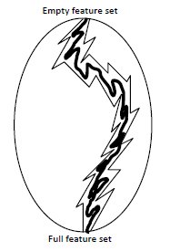
“Plus-L, minus-R” selection (LRS) (L, R are user-defined parameters)
Let A = Feature set, F = Feature subset
If L>R, and F is empty set:
Repeatedly add L features in F (by SFS)
Repeatedly remove R features from F into A
(by SBR)
If L<R, and F = A: (Is A = { }?)
Repeatedly removes R features from F (by SBR) and store them in A
Repeatedly add L features from A into F (by SFS)
Main limitation - how to choose the optimal values of L and R?

Slide 40
Example 1: LRS
Let A = {A0, A1, A2, A3, A4, A5, A6, A7, A8, A9}
Let F = { }, L=3, and R=2
As L > R, repeat following steps until a predefined number of features are selected.
Step 1: (i) By SFS, F={A1, A4, A8}, say; and A={A0,
A2, A3, A5, A6, A7, A9}
(ii) By SBR, F={A1}, say ; and now A ={A0,
A2, A3, A4, A5, A6, A7, A8, A9}
Step 2: (i) By SFS, F={A1, A0, A6, A9}, say; and
A={A2, A3, A4, A5, A7, A8}
(ii) By SBR, F={A1, A6}, say ; and now A ={A0, A2, A3, A4, A5, A7, A8, A9}

Slide 41
Is there any difference between Ex-2(i): LRS
Let A = {A0, A1, A2, A3, A4, A5, A6, A7, A8, A9}
Let F = {A0, A1, A2, A3, A4, A5, A6, A7, A8, A9}, and A={}, L=2, and R=3
As R > L, repeat following steps until a predefined number of features are left.
Step 1: (i) By SBR, F={A0, A2, A3, A5, A6, A7, A9} and
A={A1, A4, A8}
(ii) By SFS, F={A0, A2, A1, A3, A5, A6, A7, A8, A9}, say; and now A ={A4}
Step 2: (i) By SBR, F={A1, A2, A3, A6, A8, A9}, say; and A={A0, A4, A5, A7}
(ii) By SFS, F ={A1, A2, A3, A5, A6, A7, A8, A9}, say ;
and now A ={A0, A4}

Slide 42
Is there any difference between Ex-2(ii): LRS
Let A = {A0, A1, A2, A3, A4, A5, A6, A7, A8, A9}
Let F = {A0, A1, A2, A3, A4, A5, A6, A7, A8, A9}, L=2, and R=3
As R > L, repeat following steps until a predefined number of features are left.
Step 1: (i) By SBR, F={A0, A2, A3, A5, A6, A7, A9} and
A={A0, A1, A2, A3, A4, A5, A6, A7, A8, A9}
(ii) By SFS, F={A0, A2, A3, A5, A6, A7, A9}, say;
and now A ={A0, A1, A2, A4, A5, A6, A8, A9}
Step 2: (i) By SBR, F={A2, A3, A6, A9}, say; and
A={A0, A1, A2, A4, A5, A6, A7, A8, A9}
(ii) By SFS, F ={A1, A2, A3, A5, A6, A9}, say ;
and now A ={A0, A2, A4, A6, A7, A8, A9}

Slide 43
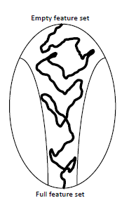
Step-wise Floating Forward Selection (SFFS) and Step-wise Floating backward Removal (SFBR)
An extension to LRS:
Rather than fixing the values of L and R, floating i.e., dynamic method of determine these values from the data.
The size of the subset during the search can be thought to be “floating” up and down
P. Pudil, J. Novovicova, J. Kittler, Floating search methods in feature selection, Pattern Recognition Lett. 15 (1994) 1119–1125.

Slide 44
Step-wise Floating Forward Selection (SFFS)
SFFS starts from the empty set.
After each forward step, SFFS performs multiple backward steps as long as the objective function increases.
Example:
Let A = {A0, A1, A2, A3, A4, A5, A6, A7, A8, A9} and F = { }
Step 1: By SFS (only once), F={A4}, say; and by multiple SBR, F={A4}, and A={A0, A1, A2, A3, A5, A6, A7, A8, A9}

Slide 45
Step-wise Floating Forward Selection (SFFS)
Step 2: By SFS (only once), F={A4, A7}, say; and by multiple SBR, F={A4, A7}, say; and A={A0, A1, A2, A3, A5, A6, A8, A9}
Step 3: By SFS (only once), F={A4, A7, A9}, say; and by multiple SBR, F={A4, A9}, say; and A={A0, A1, A2, A3, A5, A6, A7, A8}
Repeat until a predefined number of features are selected

Slide 46
Step-wise Floating backward Removal (SFBR)
SFBR starts from the full set.
After each backward step, SFBR performs multiple forward steps as long as the objective function increases.
Example:
Let A = {A0, A1, A2, A3, A4, A5, A6, A7, A8, A9} and F = {A0, A1, A2, A3, A4, A5, A6, A7, A8, A9}
Step 1: By SBR (only once) from F, F={A0, A1, A2, A3, A5, A6, A7, A8, A9}, and A = {A4} say; and by multiple SFS from A, F={A0, A1, A2, A3, A5, A6, A7, A8, A9}, and A = {A4}

Slide 47
Step-wise Floating backward Removal (SFBR)
Step 2: By SBR (only once) from F, F={A0, A2, A3, A5, A6, A7, A8, A9}, and A = {A1, A4} say; and by multiple SFS from A, F={A0, A2, A3, A5, A6, A7, A8, A9}, and A = {A1, A4}
Step 3: By SBR (only once) from F, F={A0, A2, A3, A5, A6, A8, A9}, and A = {A1, A4, A7}; and by multiple SFS from A (say, no selection), F={A0, A2, A3, A5, A6, A8, A9}, and A = {A1, A4, A7}
Step 4: By SBR (only once) from F, F={A0, A2, A3, A5, A6, A8}, and A = {A1, A4, A7, A9}; and by multiple SFS from A (say, A4 is selected), F={A0, A2, A3, A4, A5, A6, A8}, and A = {A1, A7, A9}
Repeat until a predefined number of features are selected

Slide 48
Case Study on Feature Selection
Collect various data sets using - UCI Machine Learning Repository
Apply different data pre-processing techniques and measure the similarity between a pair of objects using different similarity and dissimilarity measurement techniques.
Apply all Feature Selection methods discussed in the class on at least 5 data sets and compare their performance with respect to various classifiers in terms of Accuracy, Precision, Recall, and F-Score

Slide 49
Case Study on Feature Selection
Collect various data sets using Datasets - UCI Machine Learning Repository
Apply all Feature Selection methods discussed in the class on at least 5 data sets and compare their performance with respect to various classifiers in terms of Accuracy, Precision, Recall, and F-Score

Slide 50


